Slide 1
5 Trillion $ Economy and Role Of IPR
SUHAS KULKARNI
Asst. Controller of Patents
Patent Office , Mumbai

Slide 2
IPR
Trade-Related Aspects of Intellectual Property Rights.
It plays a central role in facilitating trade in knowledge and creativity,

Slide 3
Geographical Indication (GI)
TRIPS defines GI as any indication that identifies a product as originating from a particular place, where a given quality, reputation or other characteristics of the product are essentially attributable to its geographical origin.
A geographical indication (GI) gives exclusive right to a region (town, province or country) to use a name for a product with certain characteristics that corresponds to their specific location.

Slide 4
GI and Trade
Unfair business practices result in loss of revenue for the genuine right-holders of the GI and also misleads consumers. Moreover, such practices may eventually hamper the goodwill and reputation associated with the GI.
Competitive advantage,
More added value to a product,
Increased export opportunities,
A strengthened brand,

Slide 5
Legal framework in India
The Geographical Indications of Goods (Registration & Protection) Act, 1999’ (GI Act), and the ‘Geographical Indications of Goods (Registration and Protection) Rules, 2002 (GI Rules).

Slide 6
GI Act
The definition of GI included in Section 1(3) (e) of the Indian GI Act clarifies that for the purposes of this clause, any name which is not the name of a country, region or locality of that country “shall” also be considered as a GI if it relates to a specific geographical area and is used upon or in relation to particular goods originating from that country, region or locality,

Slide 7
GI Act
While registration of GI is not mandatory in India, Section 20 (1) of the GI Act states that no person “shall” be entitled to institute any proceeding to prevent, or to recover damages for, the infringement of an “unregistered” GI. The registration of a GI gives its registered owner and its authorized users the right to obtain relief for infringement.

Slide 8
GI Act
The GI Registry with all India jurisdictions is located in Chennai with the Controller-General of Patents, Designs and Trade Marks is the Registrar of GIs, as per Section 3(1) of the GI Act. Section 6(1) further stipulates maintenance of a GI Register which is to be divided into two parts: Part A and Part B.
The registration of the GIs are incorporated in Part A,
The particulars relating to the registration of the authorized users are contained in Part B (Section 7 of the Act).

Slide 9
Rights of GI owner
Action against passing off,
lawsuit relating to infringement of a registered GI or for passing of an unregistered GI has to be instituted in a district court having jurisdiction to try the suit.

Slide 10
International Protection
Under Articles 1 (2) and 10 of the Paris Convention for the Protection of Industrial Property, geographical indications are covered as an element of IPRs.
They are also covered under Articles 22 to 24 of the Trade Related Aspects of Intellectual Property Rights (TRIPS) Agreement.
TRIPS contains a single, identical definition for all GI, irrespective of product categories, it mandates a two-level system of protection: (i) the basic protection applicable to all GI in general (under Article 22), and
(ii) additional protection applicable only to the GI denominating wines and spirits (under Article 23).

Slide 11
CASE STUDY –TEA

Slide 12
CASE STUDY – DARJEELING TEA
Darjeeling’ tea is a premium quality tea produced in the hilly regions of the Darjeeling district West Bengal. Darjeeling tea offers distinctive characteristics of quality and flavour, and also a global reputation for more than a century

Slide 13
DARJEELING TEA
Protect “Darjeeling Tea” as Geographical Indication An adequate legal protection is necessary for the protection of legitimate right holders of Darjeeling tea from the dishonest business practices of various commercial entities.
For instance, tea produced in countries like Kenya, Sri Lanka or even Nepal has often been passed off around the world as ‘Darjeeling tea’.
Appropriate legal protection of this GI can go a long way in preventing such misuse.

Slide 14
DARJEELING Tea
•The Trade Marks Act 1999 DARJEELING word and logo are registered certification marks of Tea Board;
•The Geographical Indications of Goods (Registration and Protection) Act, 1999: DARJEELING word and logo were the first Geographical Indications is registered in India in the name of the Tea Board;
•The Copyright Act, 1957: The DARJEELING logo is copyright protected and registered as an artistic work with the Copyright Office.

Slide 15
Around the World
Use of the Darjeeling word and logo are protected as Geographical Indications in India and as Certification Trade Marks in UK, USA and India.
Use of the DARJEELING word and logo are protected as Geographical Indications (GI) in India and as Certification Trade Marks (CTM) in UK, USA, Australia and Taiwan. A major development in this area is the registration of the Darjeeling word as a Community Collective Mark (CCM) in the European Union.

Slide 16
DARJEELING
This registration is a vital step in the protection of DARJEELING, as DARJEELING will now be protected, inter alia, against any misuse, imitation or evocation or use accompanied by expressions such as "style", "type", "method", "as produced in", "imitation" or similar types in the EU countries.

Slide 17
International competition

Slide 18
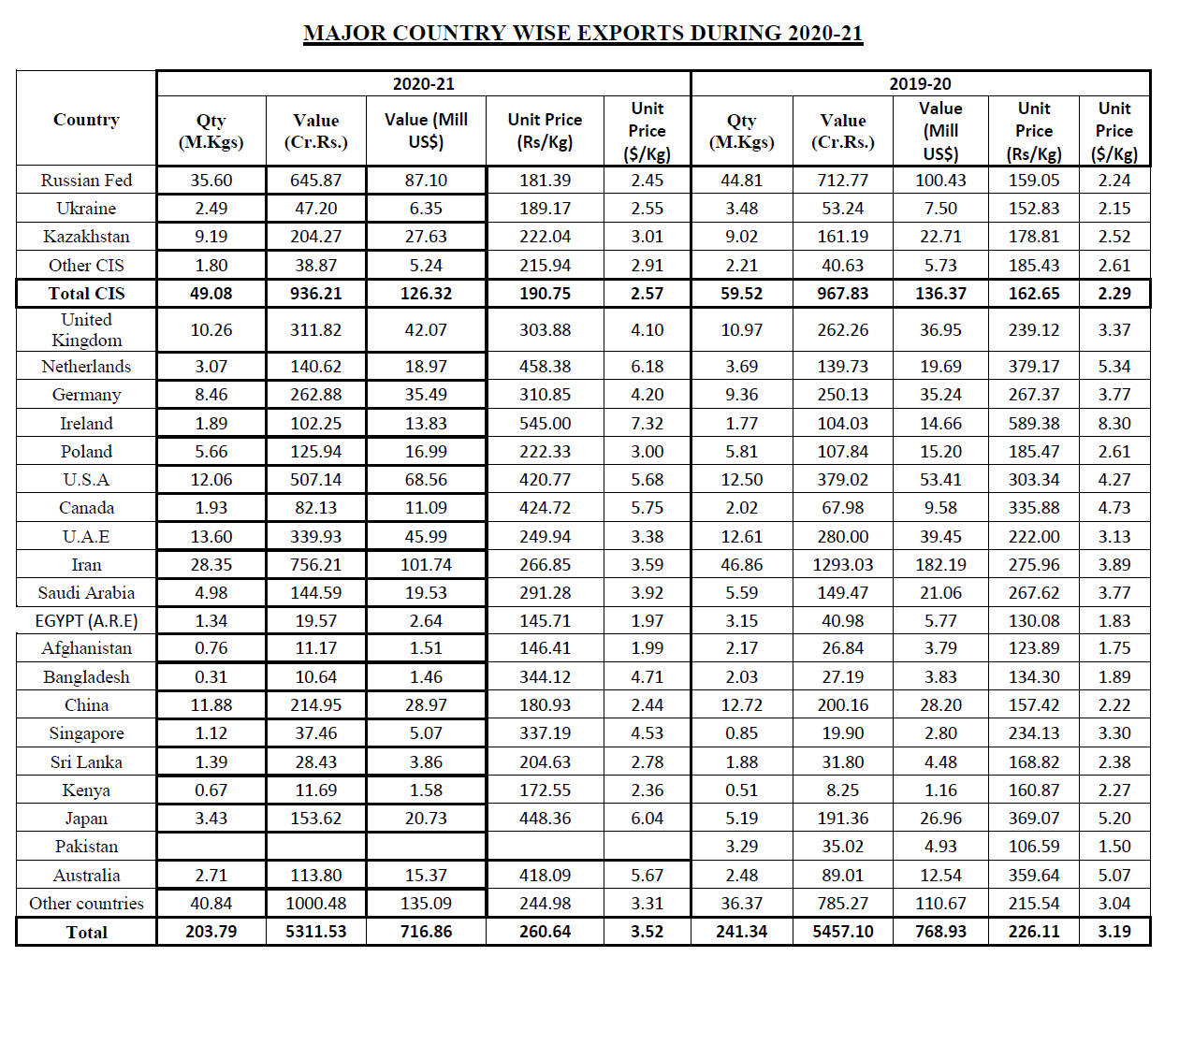

Slide 19
Have a cup of tea
recipes.timesofindia.com/

